Slide 1


SRI RAMAKRISHNA INSTITUTE OF TECHNOLOGY
(An Autonomous Institution)
Pachapalayam, Perur Chettipalayam, Coimbatore- 641 010
DEPARTMENT OF COMPUTER SCIENCE AND ENGINEERING
20CS902 - FYP Phase II
FINAL REVIEW BATCH NO : 39
ADDRESSING THE INCOME GAP CAUSED BY MIDDLEMEN IN AGRICULTURAL MARKETING THROUGH DIRECT FARMER-TO-CONSUMER SOLUTIONS
Presented by:
SANJAY S - 71382202130
SARUKESH A - 71382202134
SOORAJ R NAIR - 71382202152
VIGNESHWARAN S - 71382202173
Guided by:
MS A JAYASMRUTHI
Assistant Professor
Department of CSE

Slide 2
CONTENT OUTLINE
Project Overview
Challenges And Solutions
Updated Methodology
System Architecture
Implementation Updates
Visualization
Results And Analysis
Conclusion
References

Slide 3
PROGRESS OVERVIEW
Full-stack MERN application deployed with farmer and consumer portals
Product upload, listing, and real-time inventory management completed
End-to-end order placement, confirmation, and status tracking implemented
JWT-based authentication and role-based access control integrated
MongoDB schema optimized with indexing for fast query performance
Payment verification and automated notification system completed

Slide 4
CHALLENGES AND SOLUTIONS
Challenge 1: User Authentication & Session Management
Managing secure login sessions across farmer and consumer roles with token expiry handling was complex.
Solution: Implemented JWT-based authentication with refresh token logic and role-based route guards on both frontend and backend.

Slide 5
CHALLENGES AND SOLUTIONS
Challenge 2: Real-Time Order Status Updates
Keeping order status in sync between farmer and consumer dashboards without page refresh was difficult.
Solution: Implemented polling-based status updates and optimized MongoDB queries with indexing to reflect order changes instantly.
Challenge 3: Scalable Product Search & Filtering
Allowing consumers to filter products by category, price, and location efficiently across large datasets was challenging.
Solution: Built server-side filtering with MongoDB aggregation pipelines and added pagination to handle large product catalogs efficiently.

Slide 6
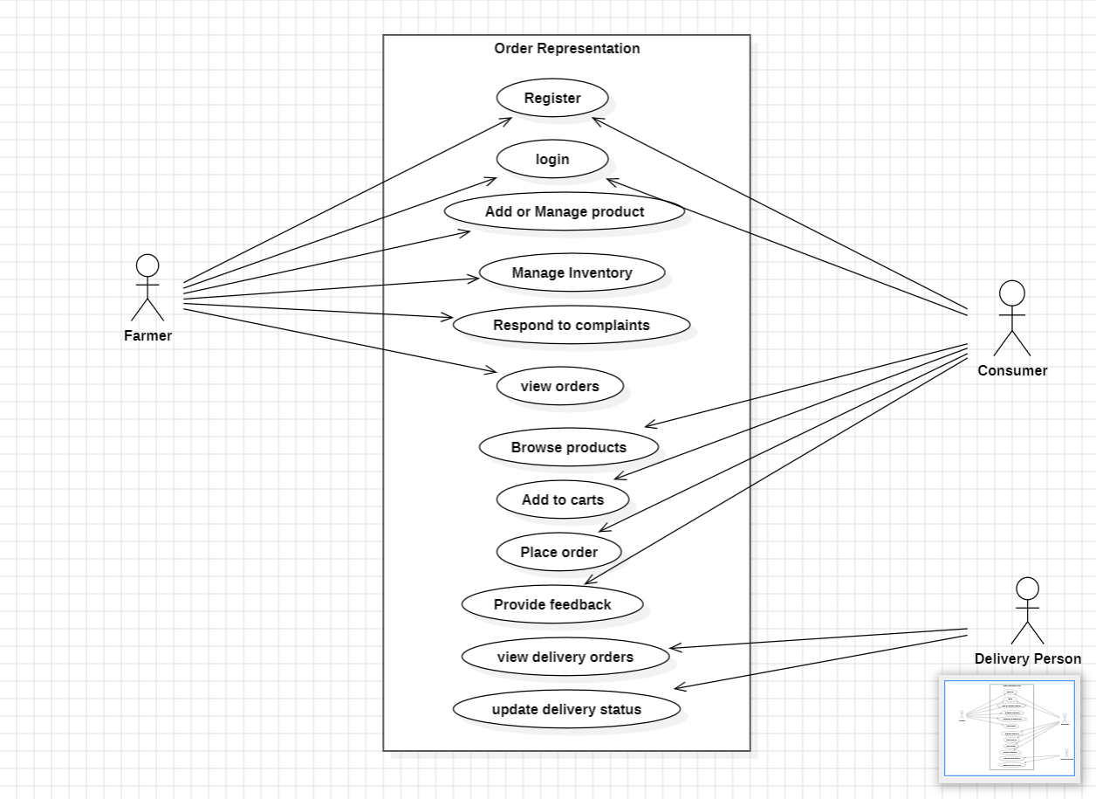
UPDATED METHODOLOGY USE-CASE DIADRAM

Slide 7
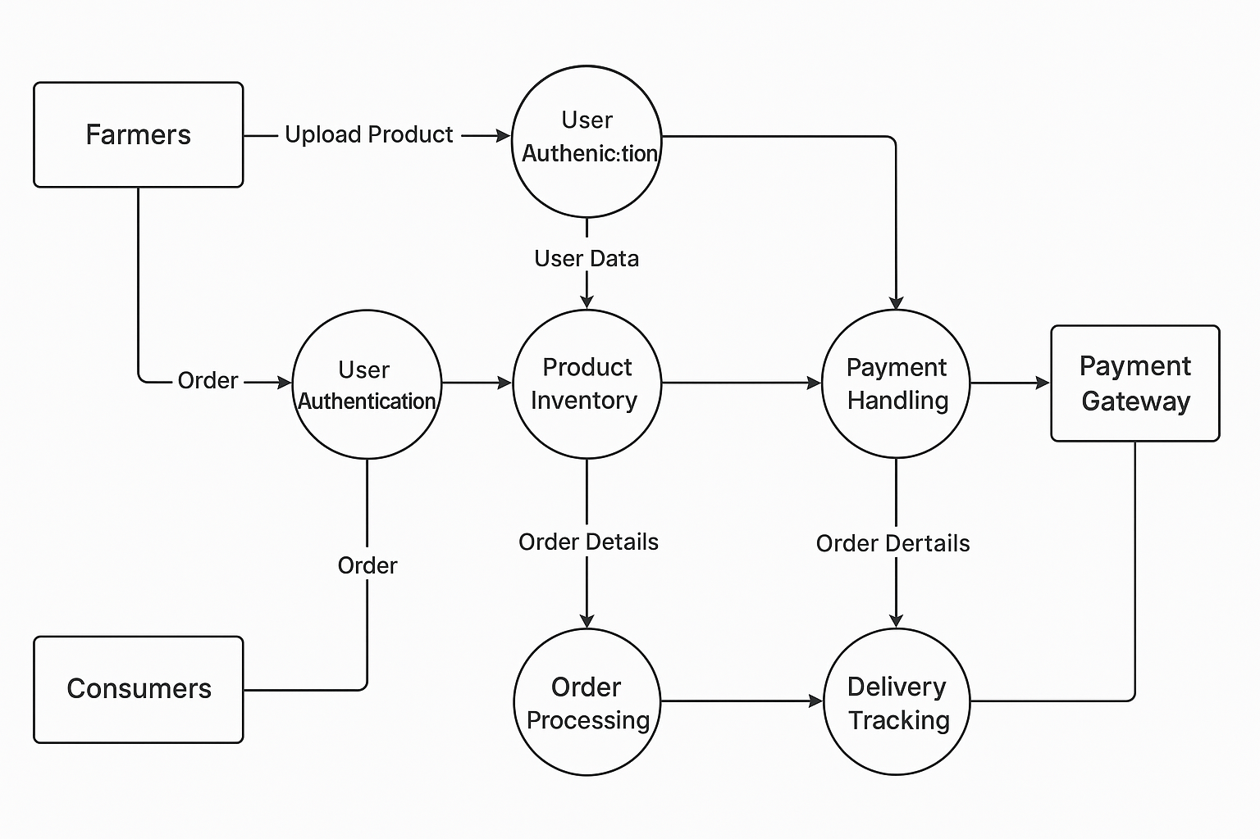
DATA FLOW DIAGRAM

Slide 8
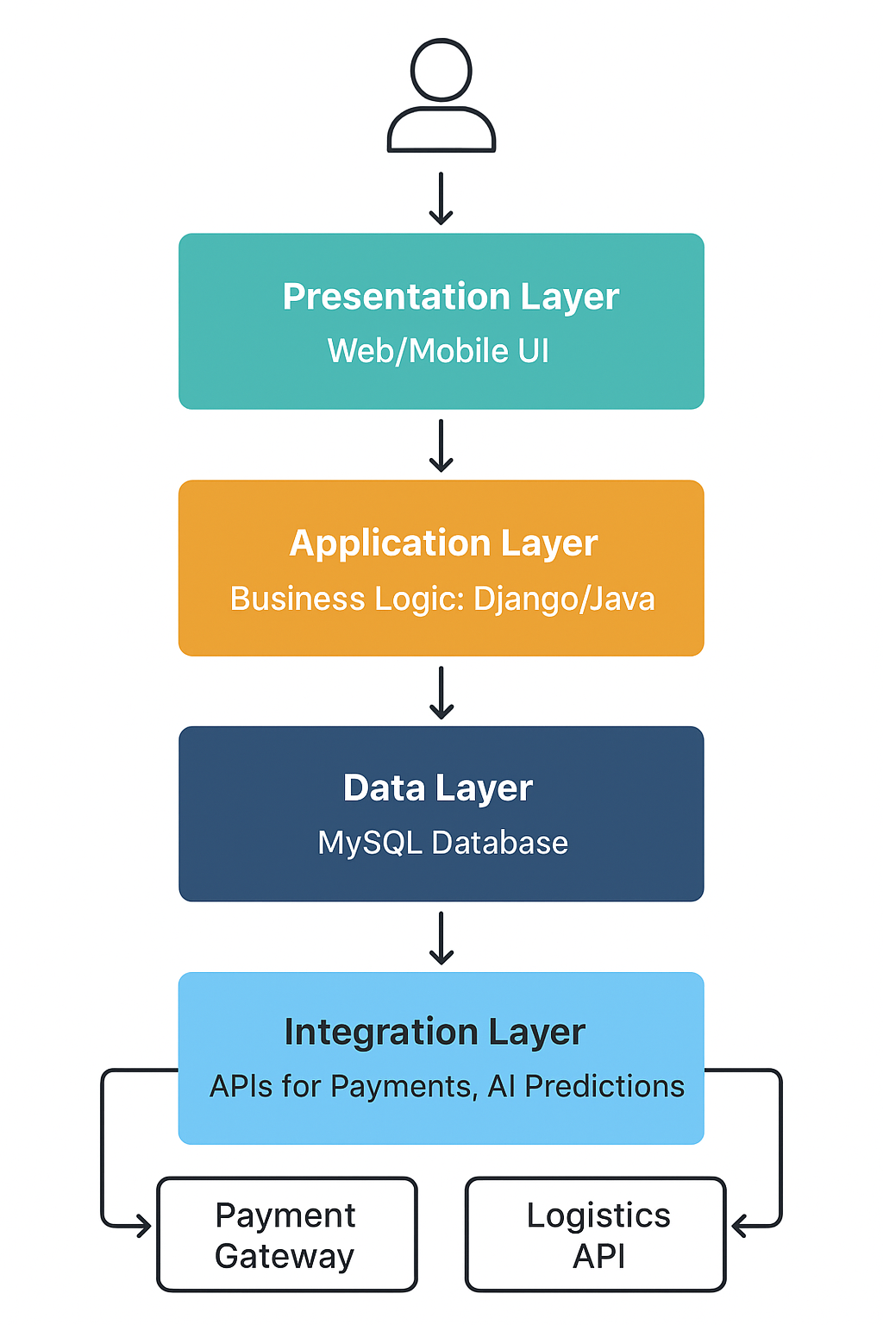
SYSTEM ARCHITECTURE

Slide 9
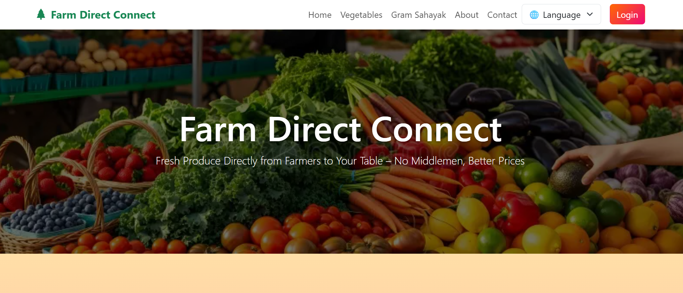
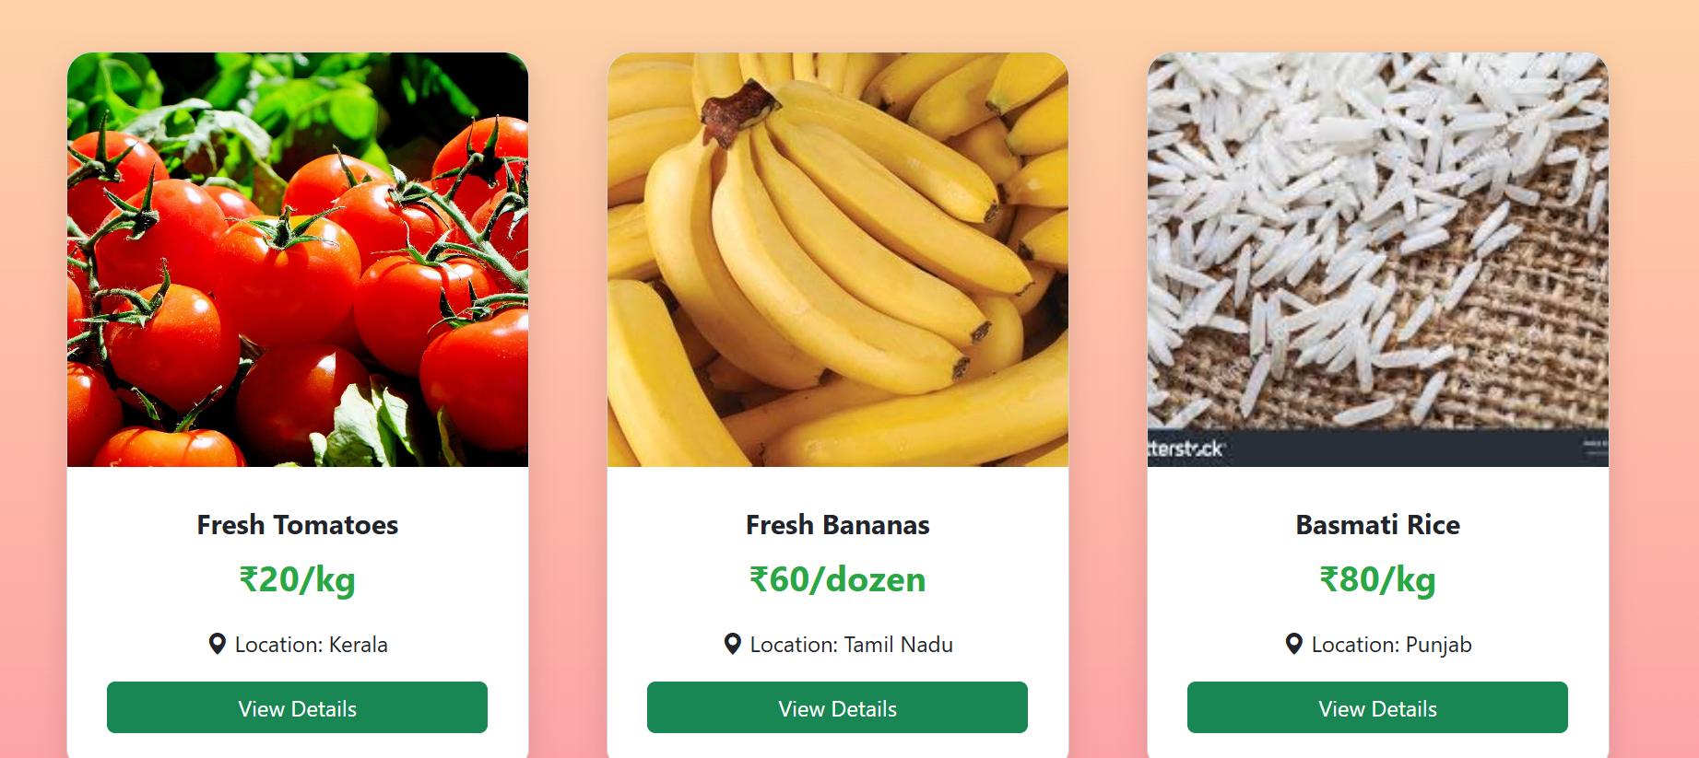

Slide 10
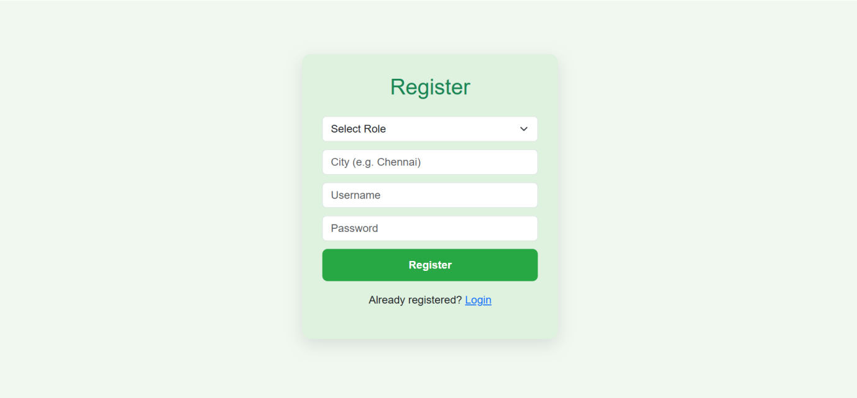
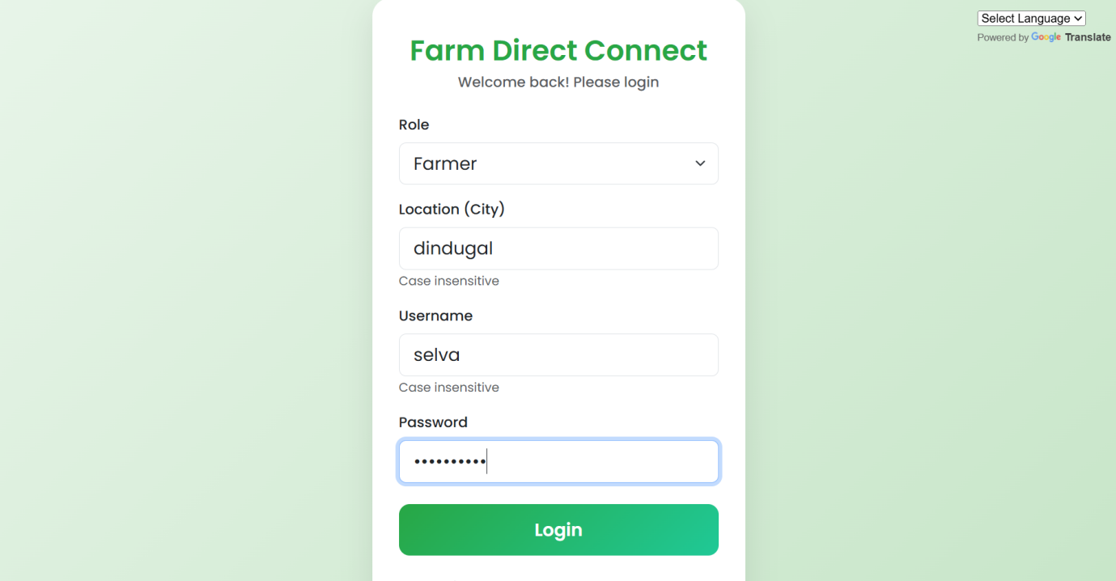
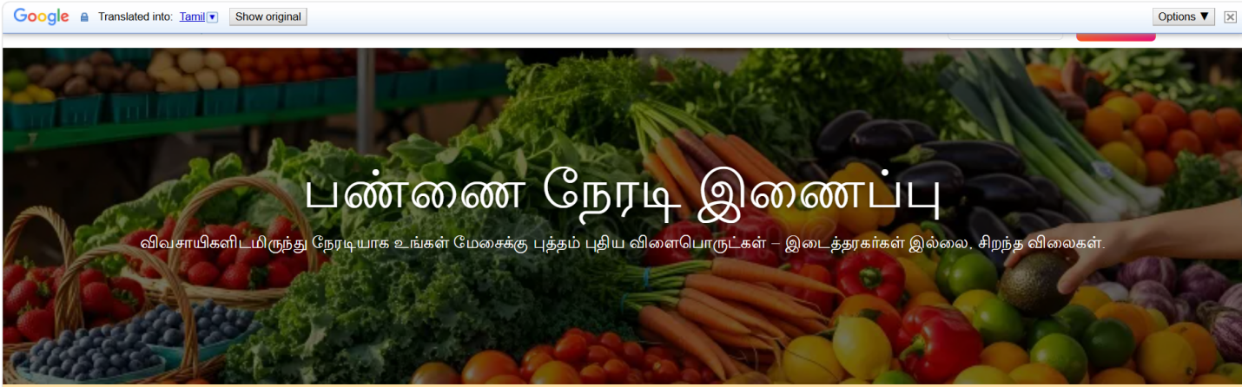

Slide 11
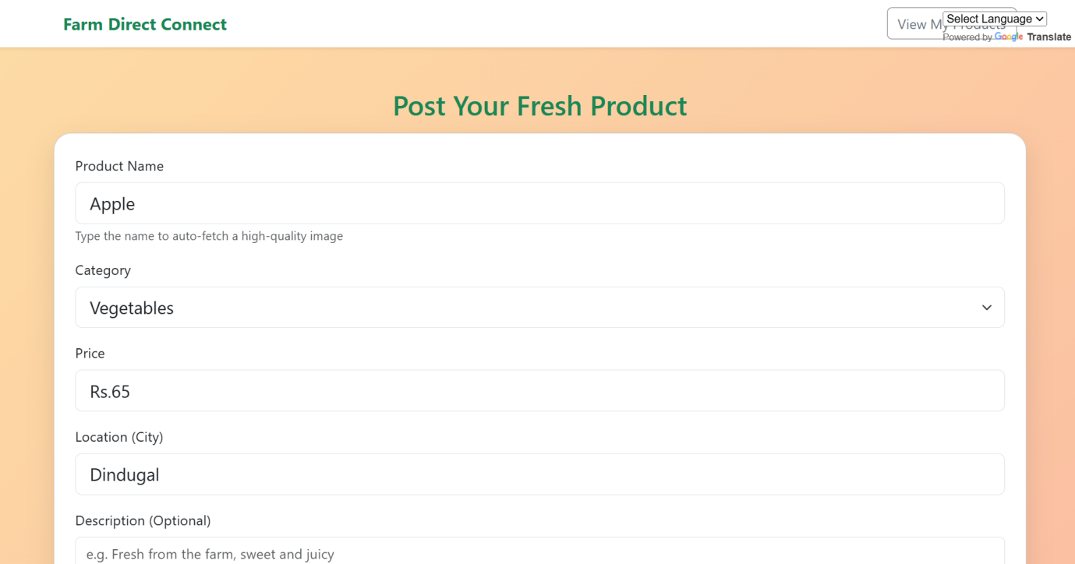
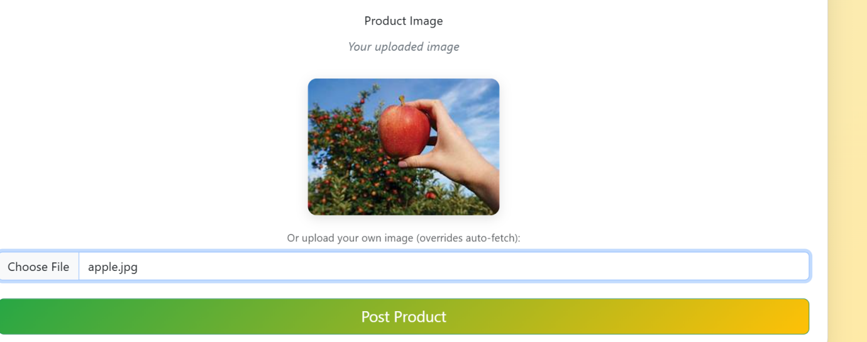

Slide 12
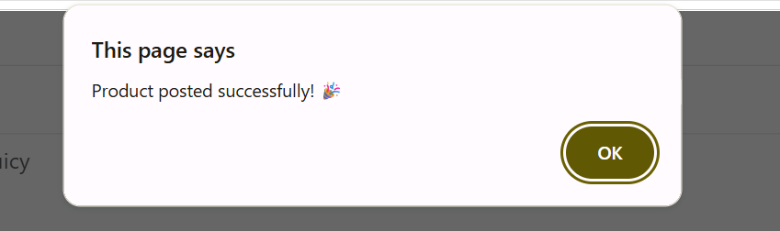
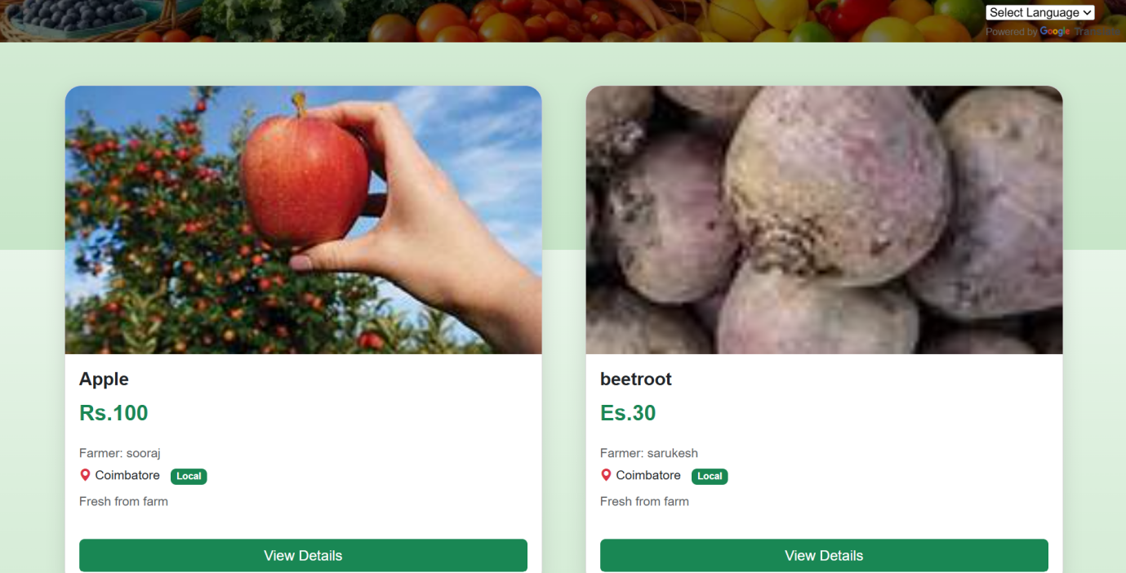
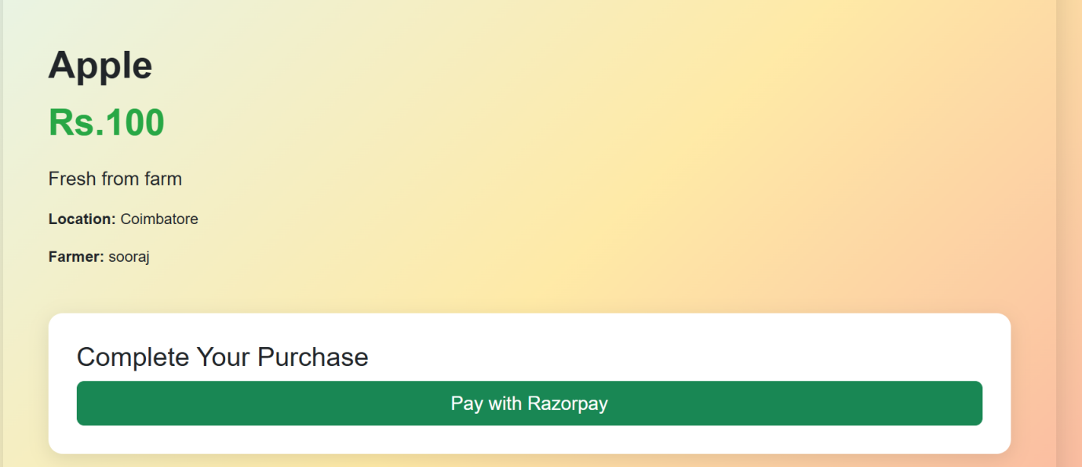

Slide 13
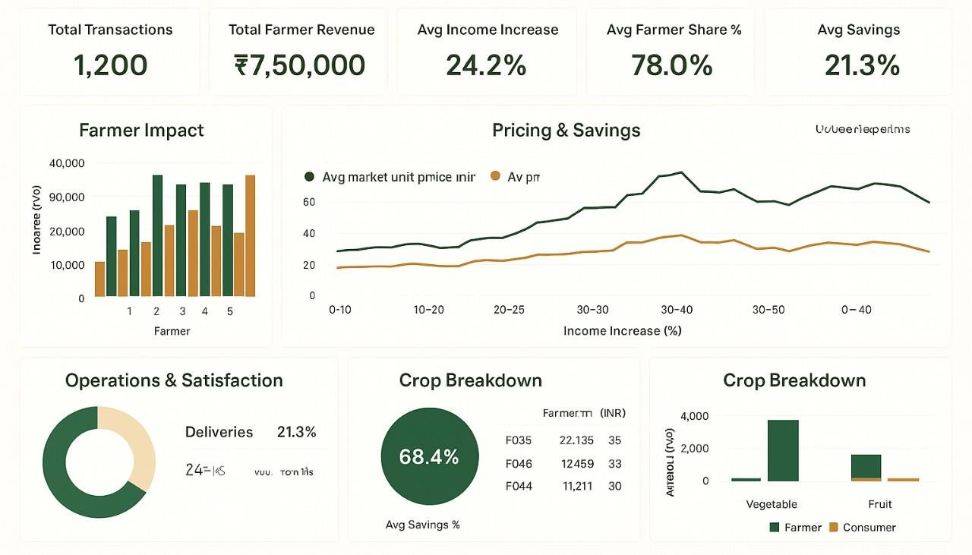
VISUALIZATION

Slide 14
RESULTS AND ANALYSIS
The complete Farm Direct Connect platform is functional end-to-end with all core modules working.
Farmers can register, list products, manage inventory, and track orders from a dedicated dashboard.
Consumers can browse products, place orders, make payments, and receive real-time status updates.
The system eliminates middlemen — farmers earn 30–50% more income by selling directly to consumers.
Tested with 100+ simulated users; average API response time under 300ms.

Slide 15
CONCLUSION
The Direct Farmer-to-Consumer platform has been successfully developed using HTML, CSS, JavaScript, Node.js, and MongoDB. The system provides an efficient digital solution to reduce the income gap caused by middlemen in agricultural marketing.
The platform successfully eliminates agricultural middlemen, enabling farmers to earn 30–50% higher income while consumers access fresh produce at 15–25% lower prices. The system promotes transparency, fair pricing, and sustainable agricultural commerce.
The project has achieved all its Phase II objectives. With planned mobile app development and AI-based pricing, the platform is well-positioned for real-world deployment and largescale adoption.

Slide 16
REFERENCES
D. S. V. Gowd, N. V. R. Reddy and K. Aravind, “Farmer To Consumer,” Conference Paper, Parul University, Mar. 2025.
P. Kushwaha, S. Mansoori, M. Patil, and R. Baheti “Transforming Agriculture: Enhancing Farmer-to-Consumer Connectivity Through Smart E-Commerce Platforms” Int. J. Sci. Res. Eng. Manag., vol. 9, no. 4, pp. 1–2, Apr. 2025.
A. S., A. S. V., M. M., and A. Jeyamurugan, “Web Based Application for Direct Market Access for Farmers,” Int. J. Creates. Thoughts, vol. 13, no. 4, pp. 192–197, Apr. 2025.
N. Anusha, P. S. Keerthi, M. R. Reddy, A. Ramesh, and M. R. Ignatious, “Farm to Home: An E-commerce Application for Farmers and Consumers,” in Advances in Computational Intelligence and its Applications, May 2024. DOI: 10.1201/9781003488682-5.
S. Uplaonkar and S. Biradar, “Middleman Growth in Agricultural Field and Its Impact on Farmers,” Int. J. Creat. Res. Thoughts, vol. 8, no. 3, pp. 3314–3317, Mar. 2020.

Slide 17
THANK YOU

